Slide 1


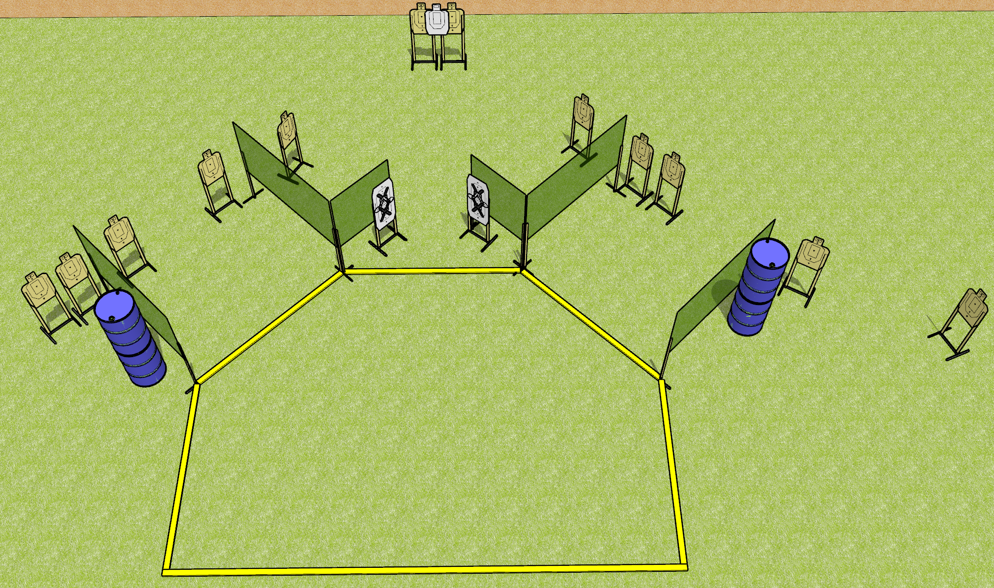
 | Dothan Gun Club – USPSA Match Blazing Course Designer : Drew Coleman Bay: 5
Round Count 24 rounds 12 USPSA
Equipment List 10 wall feet 13 targets Use 10 foot fault lines

Slide 2
Blazing
Written Stage Briefing
Scoring: Comstock Rounds: 24
Targets: 12 USPSA
Handgun start position: anywhere inside the shooting area, wrists below belt. Handgun is loaded and holstered.
PCC start position: anywhere inside the shooting area, stock on belt. Loaded carbine is held with both hands, stock on belt.
Stage Procedure: on the audible start signal, engage targets as they become available from within the shooting area.

